Slide 1
Object Oriented Programming Part 5: Data Abstraction
By: Ryan Alterman
Revised: 10-25-17

Slide 2
What is Data Abstraction?
Form of Organizing and protecting code
You allow users to see the parts of the code they need to, but nothing more
The details and structure is hidden
Separates the interface and implementation
In classes:
They create a platform for user interface, but nothing else
The mechanisms involved with a function are irrelevant
This allows us to create code that is implemented and does something
What is even cooler is that we can change the function definition and as long as the implementation stays the same, it will still work.
Abstract Data Values
Data that we don’t know the specifics of but we know it works

Slide 3
Access Labels
The Public, Private, and Protected
Defining with Public
Accessible to all parts of program
Use to put functions for the interface
Defining with Private
Not accessible to pieces using the class
So if it is not in the scope of the class, it can’t see it.
Use to hide the implementation
You can call access labels as many times as you want
It continues as long as the next label is called OR the closing brace is called

Slide 4
Why should we use this?
Protection
Protects the internals of a class from the users of the end product
I call it idiot protection
You are preventing the user from being able to break things
Easier Implementation
It may change over time due to bugs or new requirements
But the user level of the code won’t have to change
In Private sections of the class, the data can change without effects on implementation
If the public aspects change, then things might break.

Slide 5
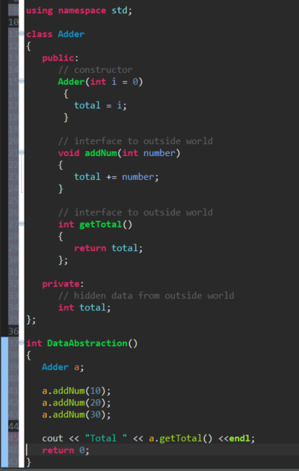
Example of Data Abstraction

Slide 6
Application of designing of code
Separates the interface from the implementation
Must keep these two aspects separate
This is so changing the implementation does not affect the user interface.
Allows you to recompile code and it works good as new.

Slide 7
Challenge
How would we use Data Abstraction in command based programming? What examples could you come up with of why we would want to protect the code from the user on an FRC team? Create a class that uses Data Abstraction to complete a piece of a current project.

Slide 8
Next: Object Oriented Programming Part 6

